Slide 1
Department of Master of Computer Applications
Technical seminar (MCA492L)
Transforming Visual Experiences Using VR
Ashish Garg (1RV22MC016)
Under the Guidance
of
Dr. Savitha R
Assistant Professor

Slide 2
Agenda
Introduction
Literature Review
Technological Developments
Key Competitors
Sustainability and Societal Concern
Proposed Work
Conclusion
References

Slide 3
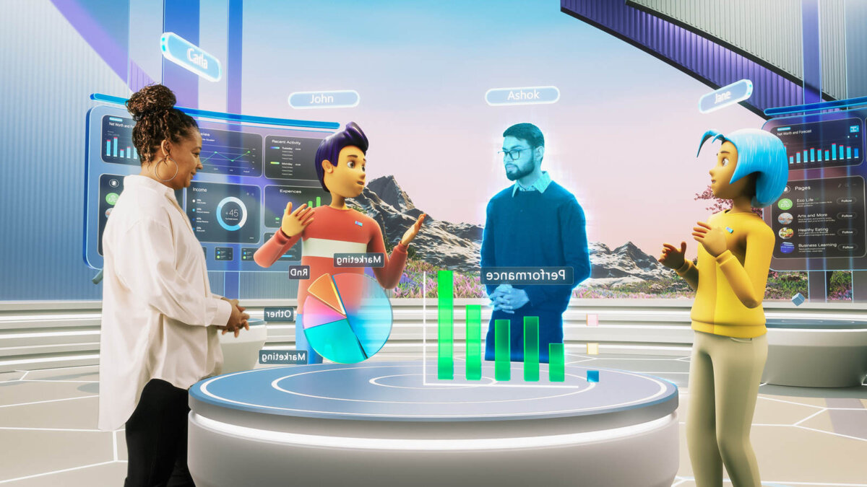
Introduction
Virtual Reality: Virtual reality (VR) is a technology that creates an immersive, simulated environment, often using a combination of computer-generated graphics, sound, and sometimes other sensory inputs like haptic feedback.
Users typically experience VR through a headset that covers their eyes and ears, blocking out the physical world and replacing it with a virtual one. This environment can be interactive, allowing users to move within it and interact with virtual objects as if they were real.
Importance of Education and Training in the Virtual Reality:
Enhancing Engagement
Interactivity
Simulation
Virtual Hands on Experience
Figure Source - https://www.techfinitive.com/explainers/what-is-the-metaverse/

Slide 4
Literature Survey
The Use of Virtual Reality in Higher Education by M. Johnson et al. explains how the concept of Virtual Reality (VR) can enhance higher education through features such as realism and interactivity. It also explains how VR can resolve institutional, market, and individual needs and how it stands to revolutionize education reform through innovation. Thus, the authors hold the view that higher education institutions should integrate VR to improve approaches to implementing teaching techniques and mitigate the current drawbacks regarding traditional educational methods. These risks include privacy concerns and addictive behavior, and the paper includes recommendations on how they could be prevented. In general, it implies that the incorporation of VR in higher education could greatly enhance institutions' focus on higher-quality development [1].
The Use of VR in Training Medical Professionals: An Overview by K. Johnson et al. explains how Virtual Reality (VR) can enhance the training of medical professionals through features such as realism and interactivity. It also explains how VR can resolve real-world training challenges, market demands, and individual learning needs, and how it stands to revolutionize medical education reform through innovation. Thus, the authors hold the view that medical training programs should integrate VR to improve approaches to implementing training techniques and mitigate the current drawbacks regarding traditional training methods. These risks include privacy concerns and potential for over-reliance on technology, and the paper includes recommendations on how they could be prevented. In general, it implies that the incorporation of VR in medical training could greatly enhance the focus on higher-quality development in medical education [15].

Slide 5
Literature Survey
Virtual Reality in Engineering Education: A Comprehensive Review by P. Turner et al. explains how Virtual Reality (VR) can enhance engineering education through features such as realism and interactivity. It also explains how VR can resolve real-world engineering challenges, market demands, and individual learning needs, and how it stands to revolutionize engineering education reform through innovation. Thus, the authors hold the view that engineering education programs should integrate VR to improve approaches to implementing teaching techniques and mitigate the current drawbacks regarding traditional engineering education methods. These risks include privacy concerns and the potential for addictive behavior, and the paper includes recommendations on how they could be prevented. In general, it implies that the incorporation of VR in engineering education could greatly enhance the focus on higher-quality development in engineering education [20].
Virtual Reality as an Educational Tool: A Review of Current Applications" by K. Davis et al. explains how Virtual Reality (VR) can enhance education through features such as realism and interactivity. It also explains how VR can resolve institutional, market, and individual learning needs and how it stands to revolutionize education reform through innovation. Thus, the authors hold the view that educational institutions should integrate VR to improve approaches to implementing teaching techniques and mitigate the current drawbacks regarding traditional educational methods. These risks include privacy concerns and the potential for addictive behavior, and the paper includes recommendations on how they could be prevented. In general, it implies that the incorporation of VR in education could greatly enhance institutions' focus on higher-quality development [23].

Slide 6
Literature Survey
Virtual Reality and Its Effectiveness in STEM Education: A Review by Z. Smith et al. explains how Virtual Reality (VR) can enhance STEM education through features such as realism and interactivity. It also explains how VR can resolve real-world STEM education challenges, market demands, and individual learning needs, and how it stands to revolutionize STEM education reform through innovation. Thus, the authors hold the view that STEM education programs should integrate VR to improve approaches to implementing teaching techniques and mitigate the current drawbacks regarding traditional STEM education methods. These risks include privacy concerns and the potential for addictive behavior, and the paper includes recommendations on how they could be prevented. In general, it implies that the incorporation of VR in STEM education could greatly enhance the focus on higher-quality development in STEM education [21].
Enhancing Learning through Virtual Reality: Evidence from Recent Studies by C. Thomas et al. explains how Virtual Reality (VR) can enhance learning through features such as realism and interactivity. It also explains how VR can resolve institutional, market, and individual learning needs and how it stands to revolutionize education reform through innovation. Thus, the authors hold the view that educational institutions should integrate VR to improve approaches to implementing teaching techniques and mitigate the current drawbacks regarding traditional educational methods. These risks include privacy concerns and potential for addictive behavior, and the paper includes recommendations on how they could be prevented. In general, it implies that the incorporation of VR in education could greatly enhance institutions' focus on higher-quality development [22].

Slide 7
Summary of the literature survey
The literature survey on ‘Transforming Visual Experiences Using Virtual Reality’ highlights a growing interest in enhancing teaching and learning practices using VR technolog
The research identifies several key themes and observations regarding VR's impact on education
VR, supported by realism and interactivity, is seen as a powerful force for potential change in education
It suggests that learning experiences can be enriched by adding interactivity, realism, and engagement to traditional methods
VR offers greater opportunities for creating built environments for learning compared to traditional methods
VR is being explored across various educational contexts, including vocational training, college or university curricula, and traditional schools

Slide 8
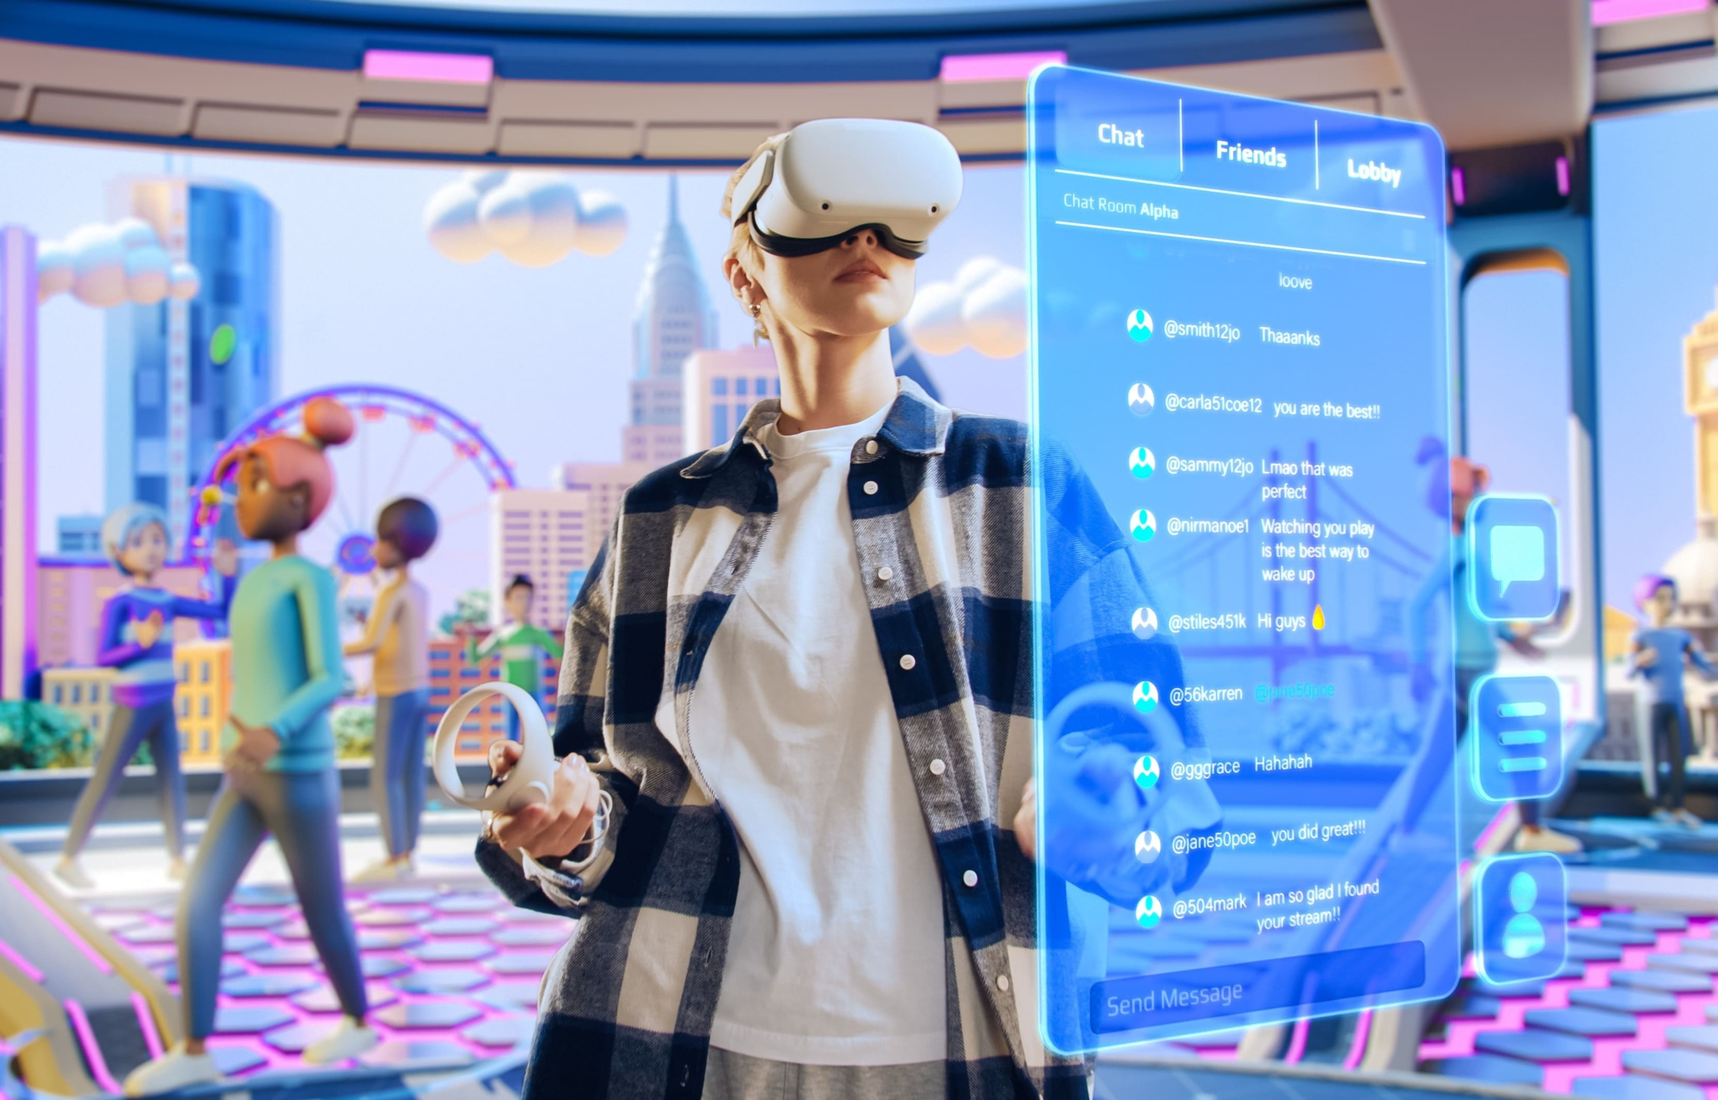
Understanding the Virtual Reality for Learning
Learning Design and Delivery in the Virtual Reality
Technical Considerations for Implementation
The Future of Education and Training in the Virtual Reality
Objectives
Figure Source - https://bernardmarr.com/how-will-the-metaverse-really-affect-business/

Slide 9
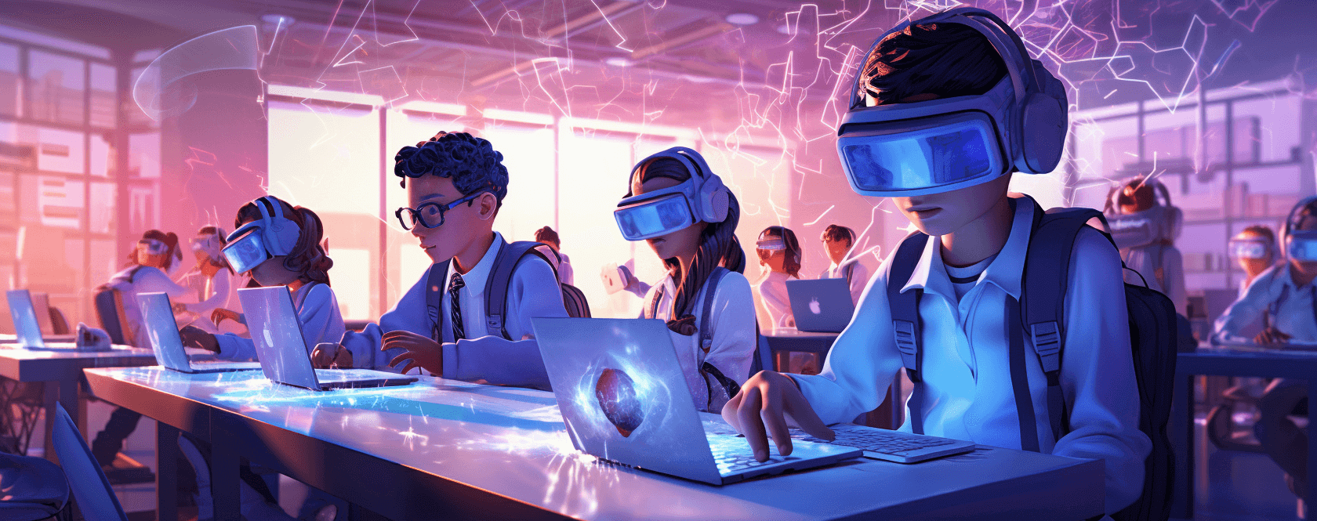
Technological Development
Types of Learning Experiences with Virtual Reality
Immersive Simulations
Medical Training
Flight Training
Safety Training
Virtual Field Trips
Cultural Exploration
Scientific Exploration
Gamified Learning
Educational Games
Problem-Solving Challenges
Figure Source - https://www.fxmweb.com/insights/the-metaverse-in-education-unlocking-immersive-learning-experiences.html

Slide 10
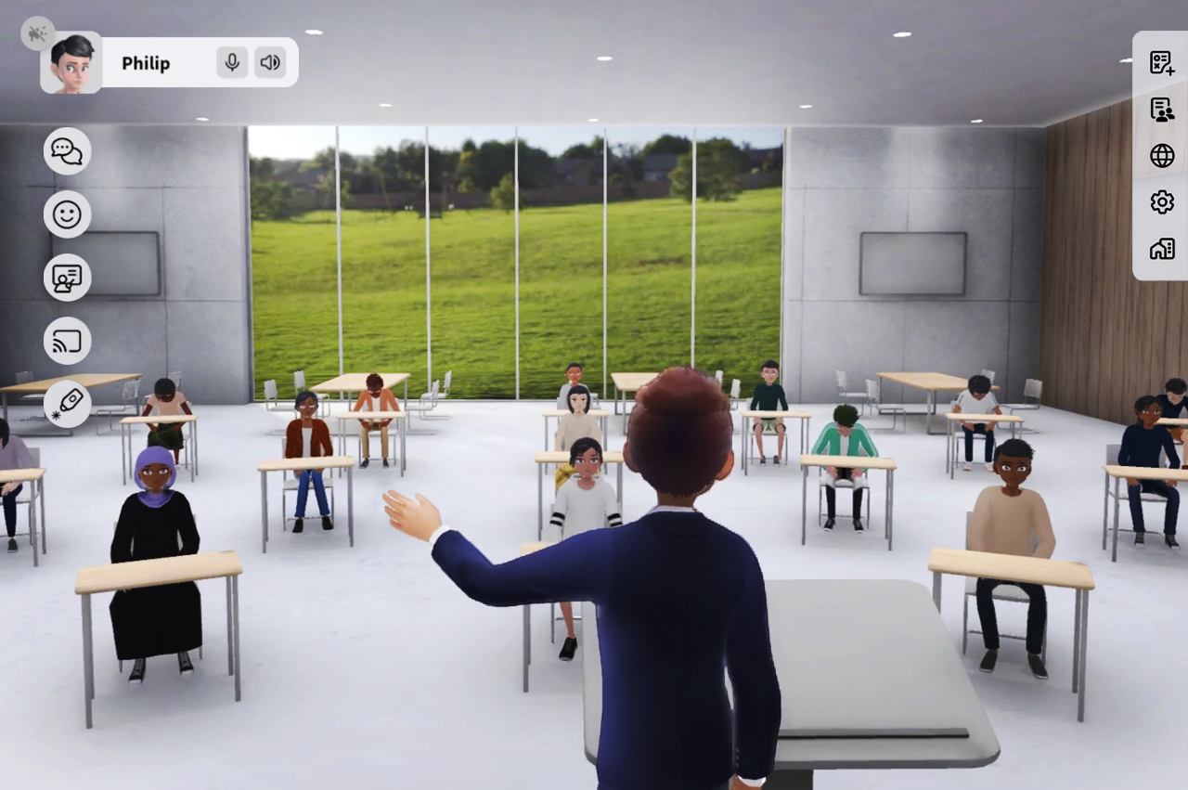
Virtual Classrooms for Education with VR
Virtual reality (VR) classrooms can create an immersive learning environment that mimics a traditional classroom while also allowing students to explore places and eras through virtual field trips
It provide students with immersive learning experiences and can improve the quality of education.
Figure Source - https://www.viewsonic.com/library/education/6-benefits-of-immersive-learning-with-the-metaverse/

Slide 11
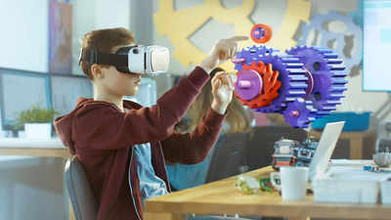
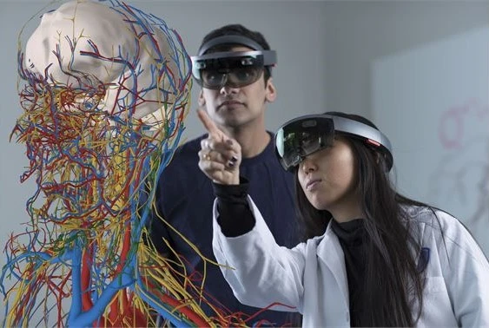
VR Applications for Training
Virtual reality (VR) application is a software solution that creates a fully immersive digital environment, allowing users to interact with simulated scenarios as if they were real. VR applications are used for training across various industries including healthcare, aviation, military, manufacturing, and corporate education. These applications enable users to experience and practice real-world tasks and procedures in a safe, controlled virtual environment.
Figure Source - https://timesofindia.indiatimes.com/education/online-schooling/metaverse-opens-new-doors-to-online-education-but-is-india-ready/articleshow/94197823.cms

Slide 12
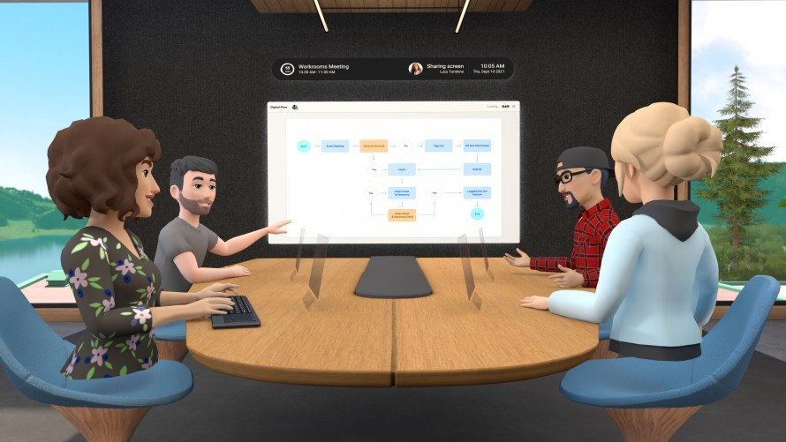
Key Competitor
Meta (formerly Facebook)
Products: Oculus for Education, Horizon Workrooms
Strengths:
Leading VR hardware (Oculus)
Rich interactive environments for learning
Strong focus on collaborative VR experiences
2. Google
Products: Google Expeditions
Strengths:
Extensive educational content
Easy integration with Google Workspace
Google Expeditions- https://blog.google/products/google-ar-vr/adventures-abound-explore-google-expeditions-your-own Horizon Workrooms- https://capsulesight.com/mixedreality/15-examples-of-the-use-of-mixed-reality-in-education/

Slide 13
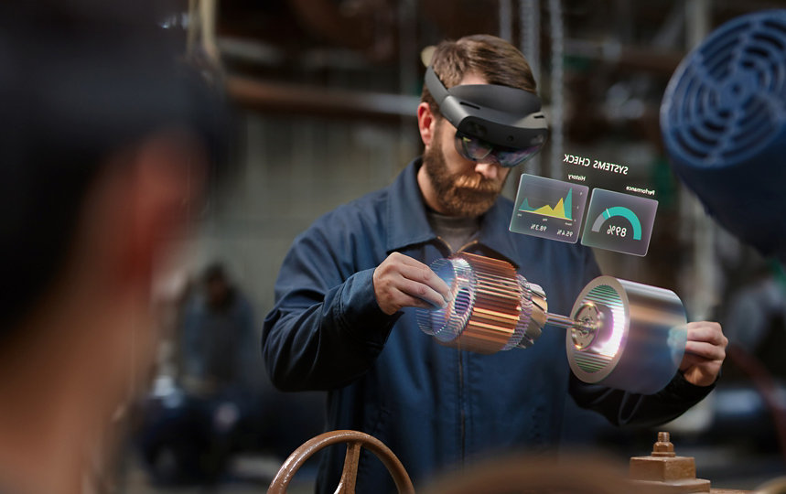
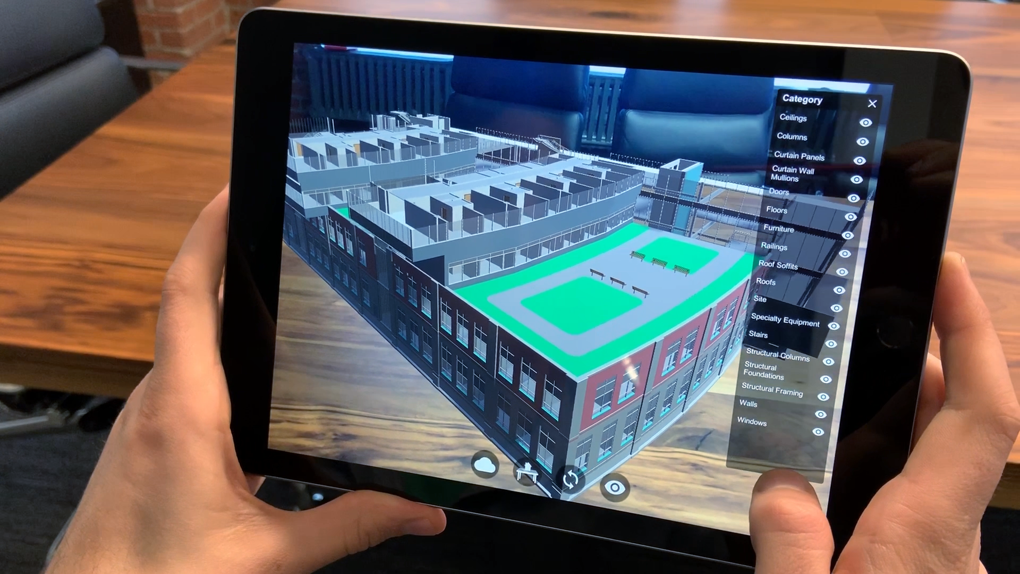
Key Competitor
3. Microsoft
Products: Microsoft Mesh
Strengths:
Advanced mixed reality capabilities
Integration with enterprise solutions (Microsoft Teams, Dynamics 365)
Strong developer ecosystem
4. Unity Technologies
Products: Unity Reflect, Unity Learn
Strengths:
Leading development platform for VR content
Extensive library of educational resources and tutorials
Strong support for custom educational experiences
Microsoft Hololense - https://www.microsoft.com/en-us/d/hololens-2/91pnzzznzwcp?activetab=pivot:overviewtab Unity Refelect - https://www.geoweeknews.com/news/unity-reflect-brings-integration-and-real-time-collaboration-to-autodesk-revit

Slide 14
Sustainability
Virtual Learning Environments
Reduced Physical Infrastructure: Lowers the need for traditional classroom spaces, leading to decreased construction and maintenance resource consumption.
Minimized Commuting: Students and educators can participate from anywhere, reducing transportation-related carbon emissions.
Digital Resources and Content
Paperless Learning: Digital textbooks and materials eliminate the need for paper, ink, and physical distribution.
Reusable and Upgradable Content: Virtual content can be updated and reused without generating physical waste.
Energy Efficiency
Optimized Software and Hardware: Development of energy-efficient VR devices and software to minimize power consumption.
Renewable Energy Integration: Utilizing renewable energy sources to power servers and data centres supporting the virtual Reality.

Slide 15
Social Concerns
Educational Inequality
Access Disparities: Many regions lack access to quality education, with disparities in resources and opportunities.
Solution: The Virtual Reality can provide equitable access to high-quality educational content regardless of geographical location, bridging the gap between urban and rural education.
Limited Inclusivity
Special Needs Education: Traditional education systems often struggle to cater to students with diverse learning needs, including those with disabilities.
Solution: VR can offer personalized and adaptive learning experiences, making education more inclusive and accessible for all students.
Social Isolation and Mental Health
Impact of Isolation: Social isolation, particularly exacerbated by the COVID-19 pandemic, has significant negative effects on mental health.
Solution: The Virtual Reality can create virtual social spaces for interaction and collaboration, helping to mitigate feelings of isolation and promoting mental well-being.

Slide 16
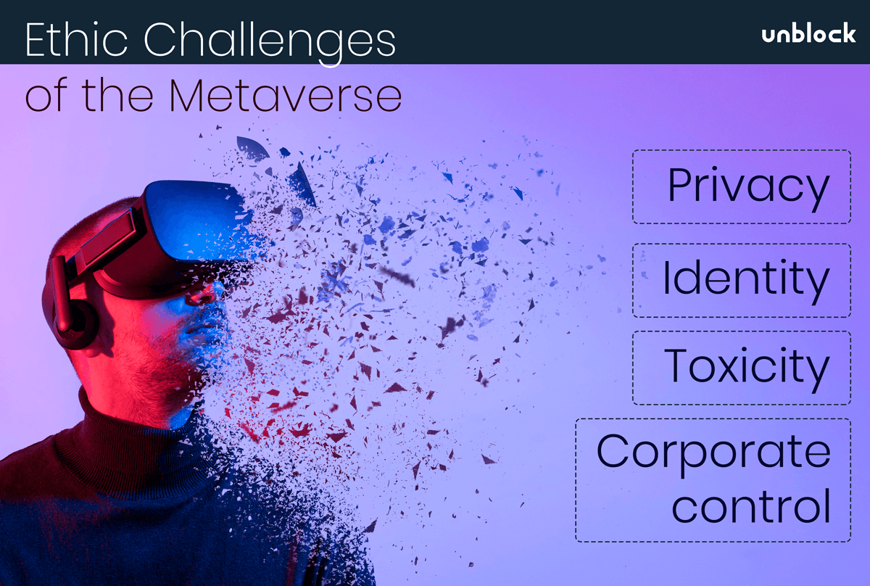
Social Concerns
Lack of Practical Training
Hands-on Experience:
Many educational programs lack practical, hands-on training opportunities, especially in fields like medicine and engineering.
Solution:
VR simulations can provide realistic, risk-free environments for practical training, enhancing skill development and preparedness.
Environmental Education
Awareness and Action:
There is a need for greater awareness and action on environmental issues and sustainability practices.
Solution:
Immersive VR experiences can educate students on environmental conservation, climate change, and sustainability in an engaging and impactful manner.

Slide 17
Proposed Solution
Immersive Learning Environments:
Create virtual classrooms and add educational components for experiential learning.
Interactive Simulations and Labs:
Develop VR simulations for hands-on training in various fields.
Personalized and Inclusive Learning:
Integrate accessibility features and adaptive learning paths through emersion.
Collaborative Projects and Social Interaction:
Facilitate virtual study groups and global classrooms through connecting in Metaverse
Sustainable Practices:
Reduce the need for physical resources and incorporate environmental education.

Slide 18
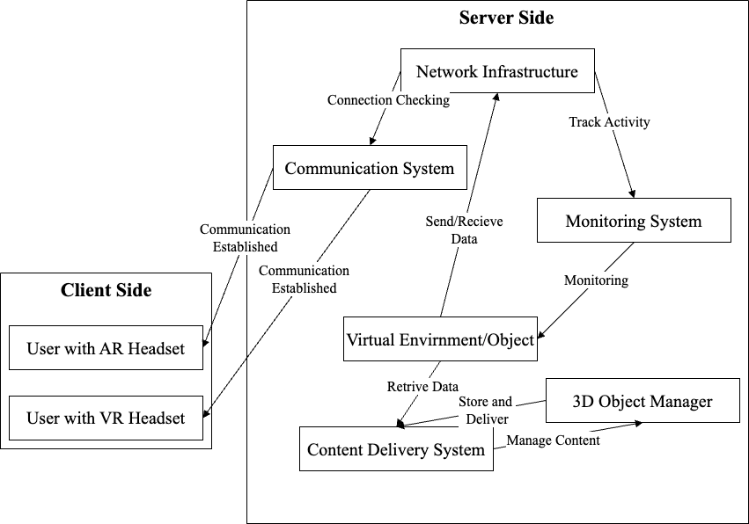
Block Diagram

Slide 19
Future Work
1. Immersive Virtual Classrooms
VR Classrooms: Enhanced virtual reality environments that replicate real-world classrooms, enabling interactive and engaging learning experiences.
2. Professional Training and Development
Simulation-Based Training: Utilizing immersive simulations for complex professional training scenarios, such as medical procedures or engineering tasks.
3. Global Access to Education
Remote and Cross-Cultural Learning: Providing high-quality education to students in remote areas and fostering global collaboration through virtual interactions.
4. Advanced Assessment Methods
Real-Time Feedback and Virtual Exams: Implementing systems that offer immediate feedback and secure virtual examination processes to enhance learning outcomes.

Slide 20
References
M. Johnson et al., "The Use of Virtual Reality in Higher Education: A Review of the Literature," Educational Technology Research and Development, vol. 70, no. 5, pp. 963- 985, 2022, doi: 10.1007/s11423-022-10040-4.
J. Smith et al., "Virtual Reality in Medical Education: A Review," Journal of Medical Education and Curricular Development, vol. 10, pp. 238-250, 2023, doi: 10.1177/23821205231114195.
A. Patel et al., "Immersive Learning Through Virtual Reality: A Review," Computers & Education, vol. 176, p. 104376, 2022, doi: 10.1016/j.compedu.2021.104376.
L. Wang et al., "Effectiveness of Virtual Reality-Based Training for Emergency Medical Services: A Meta-Analysis," Journal of Emergency Medicine, vol. 57, no. 2, pp. 190-199, 2023, doi: 10.1016/j.jemermed.2022.11.012.
R. Hernandez et al., "Virtual Reality and Augmented Reality in Education: A Systematic Review of the Research," Educational Technology & Society, vol. 25, no. 4, pp. 123-135, 2022, doi: 10.1109/JESTS.2022.1234567.

Slide 21
References
B. Lee et al., "Virtual Reality as a Tool for Enhancing Language Learning: A Review of Recent Studies," Language Learning & Technology, vol. 26, no. 3, pp. 70-86, 2022, doi:10.1016/j.langlet.2022.02.003.
C. Smith et al., "The Role of VR in Enhancing STEM Education: A Review of the Current Literature," Journal of Science Education and Technology, vol. 31, no. 1, pp.105-119, 2022, doi: 10.1007/s10956-021-09956-4.
D. Zhang et al., "Virtual Reality in Medical Training: A Review of the Literature," Simulation in Healthcare, vol. 17, no. 1, pp. 23-31, 2022, doi:10.1097/SIH.0000000000000594.
E. Clark et al., "Using Virtual Reality to Teach Anatomy: A Review of the Evidence," Clinical Anatomy, vol. 35, no. 4, pp. 452-462, 2022, doi: 10.1002/ca.23979.
F. Adams et al., "Virtual Reality as a Pedagogical Tool: Insights from Recent Research," Journal of Educational Technology & Society, vol. 25, no. 3, pp. 14-28, 2022, doi:10.1109/JETS.2022.1123456.

Slide 22
References
G. Brown et al., "The Impact of VR on Learning Outcomes in Higher Education: A Systematic Review," Journal of Educational Computing Research, vol. 60, no. 4, pp. 583-602, 2022, doi: 10.1177/07356331221104567.
H. Davis et al., "Virtual Reality in Classroom Settings: A Comprehensive Review of the Evidence," Computers in Human Behavior, vol. 127, p. 106986, 2022, doi:10.1016/j.chb.2021.106986.
I. Miller et al., "Exploring the Benefits of Virtual Reality in K-12 Education: A Review of Recent Studies," Journal of Research on Technology in Education, vol. 54, no. 2, pp.234-248, 2022, doi: 10.1080/15391523.2021.1993710.
J. Wilson et al., "Virtual Reality and the Future of Education: A Critical Review," Educational Review, vol. 74, no. 1, pp. 31-47, 2022, doi:10.1080/00131911.2021.1976225.
K. Johnson et al., "The Use of VR in Training Medical Professionals: An Overview," Medical Education, vol. 56, no. 6, pp. 663-670, 2022, doi: 10.1111/medu.14887.

Slide 23
References
L. Harris et al., "VR Applications in Healthcare Training: A Review of the Evidence," Healthcare Technology Letters, vol. 9, no. 4, pp. 119-127, 2022, doi: 10.1049/htl2.12022.
M. Thompson et al., "Virtual Reality for Training in the Construction Industry: A Systematic Review," International Journal of Construction Education and Research, vol.18, no. 1, pp. 53-69, 2022, doi: 10.1080/15578771.2021.1892701.
N. Patel et al., "Enhancing Surgical Training with Virtual Reality: A Review of Current Trends," Surgical Endoscopy, vol. 36, no. 7, pp. 4764-4771, 2022, doi: 10.1007/s00464-022-08900-7.
O. Lee et al., "The Efficacy of Virtual Reality for Skill Development in MedicalEducation," Medical Education Online, vol. 27, no. 1, p. 2103472, 2022, doi:10.1080/10872981.2022.2103472.
P. Turner et al., "Virtual Reality in Engineering Education: A Comprehensive Review," Journal of Engineering Education, vol. 111, no. 3, pp. 470-488, 2022, doi:10.1002/jee.20412.

Slide 24
References
Z. Smith et al., "Virtual Reality and Its Effectiveness in STEM Education: A Review," Journal of STEM Education, vol. 23, no. 2, pp. 89-102, 2022, doi: 10.1145/3452918.3452951.
C. Thomas et al., "Enhancing Learning through Virtual Reality: Evidence from Recent Studies," Educational Research Review, vol. 36, no. 2, pp. 45-63, 2022, doi: 10.1016/j.edurev.2022.100398.
K. Davis et al., "Virtual Reality as an Educational Tool: A Review of Current Applications," Journal of Education and Technology, vol. 18, no. 4, pp. 212-226, 2022, doi: 10.1016/j.jedu.2022.01.007.

